Slide 1
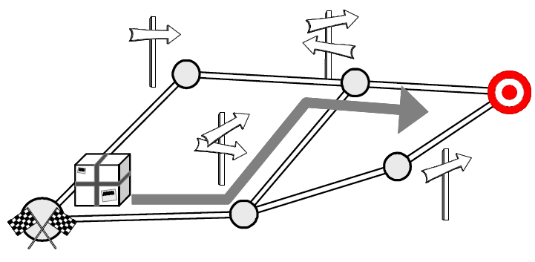
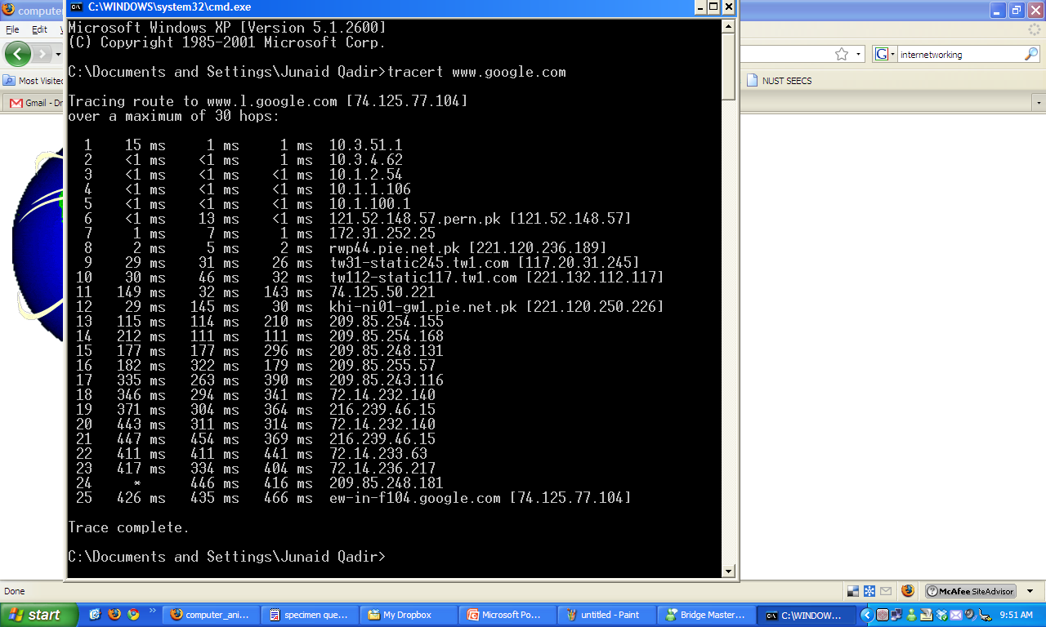
Topic 3; Lecture 2
How to route packets?
Notes:
In the previous lectures, we have assumed that the switches and routers have enough knowledge of the network topology so they can choose the right port onto which each packet should be output. In the case of virtual circuits, routing is an issue only for the connection request packet; all subsequent packets follow the same path as the request. In datagram networks, including IP networks, routing is an issue for every packet. In either case, a switch or router needs to be able to look at the packet’s destination address and then to determine which of the output ports is the best choice to get the packet to that address. As we saw in previous lectures, the switch makes this decision by consulting a forwarding table. The fundamental problem of routing is, How do switches and routers acquire the information in their forwarding tables?

Slide 2
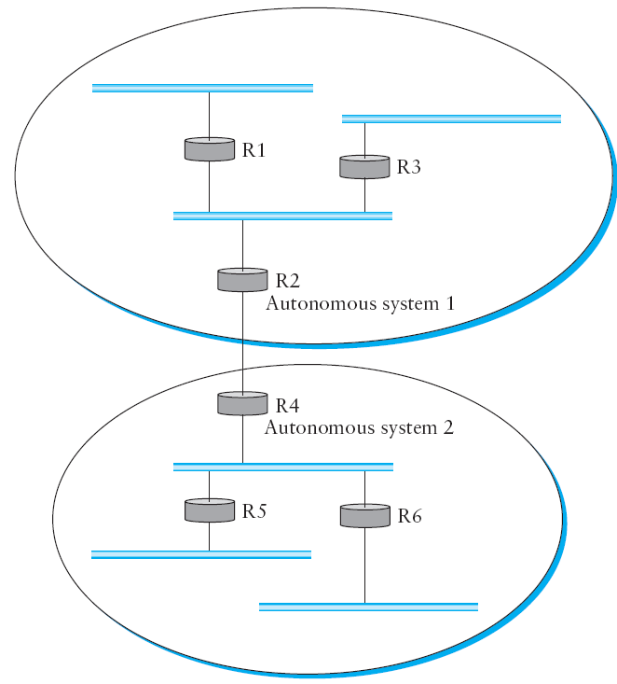
Part III - Inter-AS Routing
Notes:
In the previous lectures, we introduced the notion that the Internet is organized as autonomous systems, each of which is under the control of a single administrative entity. A corporation’s complex internal network might be a single AS, as may the network of a single Internet service provider. The figure above shows a simple network with two autonomous systems.
The basic idea behind autonomous systems is to provide an additional way to hierarchically aggregate routing information in a large internet, thus improving scalability. We now divide the routing problem into two parts: routing within a single autonomous system and routing between autonomous systems. Since another name for autonomous systems in the Internet is routing domains, we refer to the two parts of the routing problem as inter-domain routing and intra-domain routing.
In addition to improving scalability, the AS model decouples the intra-domain routing that takes place in one AS from that taking place in another. Thus, each AS can run whatever intra-domain routing protocols it chooses. It can even use static routes or multiple protocols if desired. The inter-domain routing problem is then one of having different ASs share reachability information with each other.
One feature of the autonomous system idea is that it enables some ASs to dramatically reduce the amount of routing information they need to care about by using default routes. For example, if a corporate network is connected to the rest of the Internet by a single router (this router is typically called a border router since it sits at the boundary between the AS and the rest of the Internet), then it is pretty easy for a host or router inside the autonomous system to figure out where it should send packets that are headed for a destination outside of this AS—they first go to the AS’s border router. This is the default route. Similarly, a regional Internet service provider can keep track of how to reach the networks of all its directly connected customers and can have a default route to some other provider (typically a backbone provider) for everyone else. Of course, this passing of the buck has to stop at some point; eventually the packet should reach a router connected to a backbone network that knows how to reach everything. Managing the amount of routing information in the backbones is an important issue that we discuss below.

Slide 3
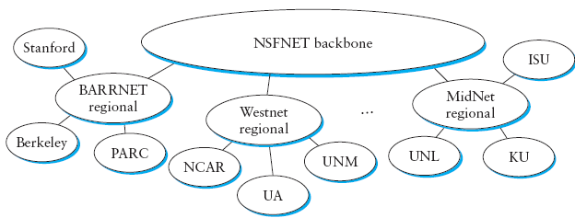
Motivations of AS
Autonomy: routing policies can be managed autonomously
Scalability: most of the AS routers do not need to know the complete complexity of the Internet through the use of default (or aggregated) routes
Notes:
Whereas the discussion of routing in the previous week’s lectures (IGP routing – DV and LS) focused on finding optimal paths based on minimizing some sort of link metric, the problem of inter-domain routing turns out to be so difficult that the goals are more modest.
First and foremost, the goal is to find any path to the intended destination that is loop-free. That is, we are more concerned with reachability than optimality. Finding a path that is anywhere close to optimal is considered a great achievement.We will see why this is so as we look at the details of BGP.
Now, we are in a position to discuss the two major inter-domain routing protocols in the recent history of the Internet.
1) The first was the Exterior Gateway Protocol (EGP). EGP had a number of limitations, perhaps the most severe of which was that it constrained the topology of the Internet rather significantly. EGP basically forced a treelike topology onto the Internet, or to be more precise, it was designed when the Internet had a treelike topology. EGP did not allow for the topology to become more general. Note that in this simple treelike structure, there is a single backbone, and autonomous systems are connected only as parents and children and not as peers.
2) The replacement for EGP is the Border Gateway Protocol (BGP), which is in its fourth version at the time of this writing (BGP-4). BGP is also known for being rather complex. This section presents the highlights of BGP-4. As a starting position, BGP assumes that the Internet is an arbitrarily interconnected set of ASs. This model is clearly general enough to accommodate non-tree structured internetworks, like the simplified picture of today’s multi-backbone Internet shown in the previous slide.
Unlike the simple tree-structured Internet shown in Figure 4.24, today’s Internet consists of an interconnection of multiple backbone networks (they are usually called service provider networks, and they are operated by private companies rather than the government), and sites are connected to each other in arbitrary ways. Some large corporations connect directly to one or more of the backbones, while others connect to smaller, non-backbone service providers. Many service providers exist mainly to provide service to “consumers” (i.e., individuals with PCs in their homes), and these providers must also connect to the backbone providers. Often many providers arrange to interconnect with each other at a single “peering point.” In short, it is hard to discern much structure at all in today’s Internet.
Given this rough sketch of the Internet, if we define local traffic as traffic that originates at or terminates on nodes within an AS, and transit traffic as traffic that passes through an AS, we can classify ASs into three types:
■ Stub AS: an AS that has only a single connection to one other AS; such an AS will only carry local traffic. The small corporation in the figure above is an example of a stub AS.
■ Multihomed AS: an AS that has connections to more than one other AS but that refuses to carry transit traffic; for example, the large corporation at the top of the figure above.
■ Transit AS: an AS that has connections to more than one other AS and that is designed to carry both transit and local traffic, such as the backbone providers in the figure above.

Slide 4
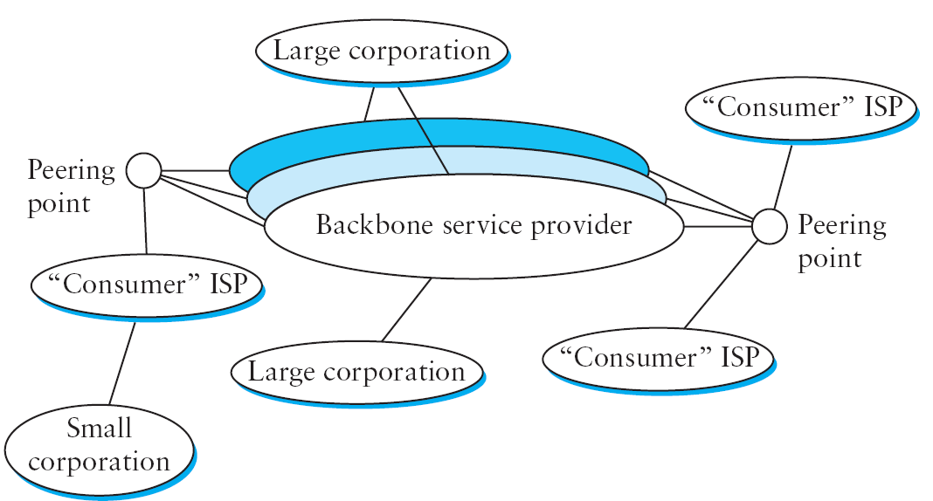
Classifications of AS
Multihomed AS
Transit AS
Stub AS
Notes:
Whereas the discussion of routing in the previous week’s lectures (IGP routing – DV and LS) focused on finding optimal paths based on minimizing some sort of link metric, the problem of inter-domain routing turns out to be so difficult that the goals are more modest.
First and foremost, the goal is to find any path to the intended destination that is loop-free. That is, we are more concerned with reachability than optimality. Finding a path that is anywhere close to optimal is considered a great achievement. We will see why this is so as we look at the details of BGP.
Now, we are in a position to discuss the two major inter-domain routing protocols in the recent history of the Internet.
1) The first was the Exterior Gateway Protocol (EGP). EGP had a number of limitations, perhaps the most severe of which was that it constrained the topology of the Internet rather significantly. EGP basically forced a treelike topology onto the Internet, or to be more precise, it was designed when the Internet had a treelike topology. EGP did not allow for the topology to become more general. Note that in this simple treelike structure, there is a single backbone, and autonomous systems are connected only as parents and children and not as peers.
2) The replacement for EGP is the Border Gateway Protocol (BGP), which is in its fourth version at the time of this writing (BGP-4). BGP is also known for being rather complex. This section presents the highlights of BGP-4. As a starting position, BGP assumes that the Internet is an arbitrarily interconnected set of ASs. This model is clearly general enough to accommodate non-tree structured internetworks, like the simplified picture of today’s multi-backbone Internet shown in the previous slide.
Unlike the simple tree-structured Internet shown in Figure 4.24, today’s Internet consists of an interconnection of multiple backbone networks (they are usually called service provider networks, and they are operated by private companies rather than the government), and sites are connected to each other in arbitrary ways. Some large corporations connect directly to one or more of the backbones, while others connect to smaller, non-backbone service providers. Many service providers exist mainly to provide service to “consumers” (i.e., individuals with PCs in their homes), and these providers must also connect to the backbone providers. Often many providers arrange to interconnect with each other at a single “peering point.” In short, it is hard to discern much structure at all in today’s Internet.
Given this rough sketch of the Internet, if we define local traffic as traffic that originates at or terminates on nodes within an AS, and transit traffic as traffic that passes through an AS, we can classify ASs into three types:
■ Stub AS: an AS that has only a single connection to one other AS; such an AS will only carry local traffic. The small corporation in the figure above is an example of a stub AS.
■ Multihomed AS: an AS that has connections to more than one other AS but that refuses to carry transit traffic; for example, the large corporation at the top of the figure above.
■ Transit AS: an AS that has connections to more than one other AS and that is designed to carry both transit and local traffic, such as the backbone providers in the figure above.

Slide 5
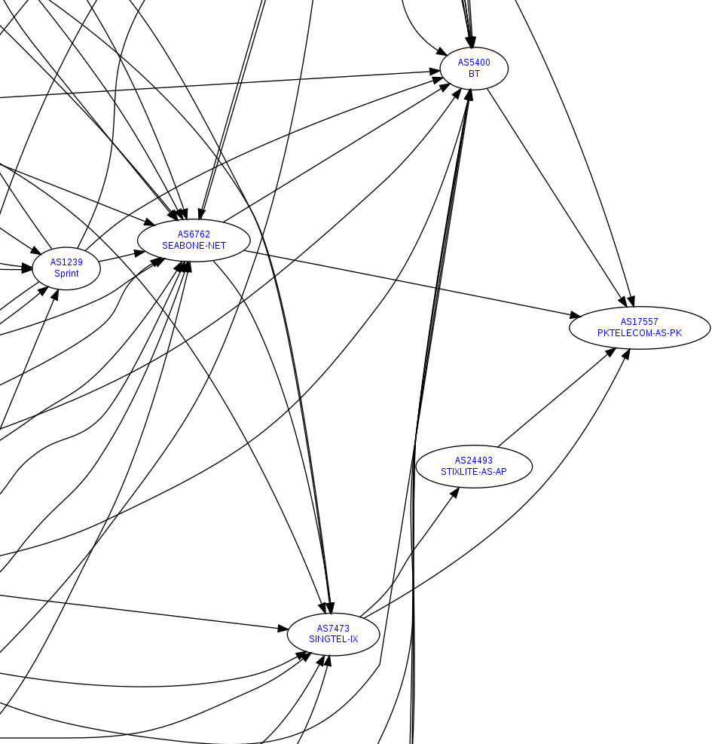
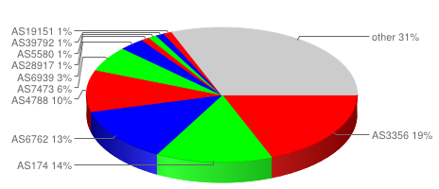
Practical Example: PTCL AS
PTCL
AS 17557
http://www.robtex.com/as/as17557.html

Slide 6
Challenges in Interdomain Routing (1)
Matter of scale
~300,000 routes (or network prefixes) in Internet’s BGP table
The objectives in such large-scale routing is more modest.
Our goal, more specifically, is:
To have loop-free routing that is policy compliant
Notes:
There are a few reasons why inter-domain routing is hard.
The first challenge is simply a matter of scale. An Internet backbone router must be able to forward any packet destined anywhere in the Internet. That means having a routing table that will provide a match for any valid IP address. While CIDR has helped to control the number of distinct prefixes that are carried in the Internet’s backbone routing, there is inevitably a lot of routing information to pass around—on the order of 200,000 prefixes at the time of writing.
The third challenge involves the issue of trust. Provider A might be unwilling to believe certain advertisements from provider B for fear that provider B will advertise erroneous routing information. For example, trusting provider B when he advertises a great route to anywhere in the Internet can be a disastrous choice if provider B turns out to have made a mistake configuring his routers or to have insufficient capacity to carry the traffic. Closely related to this issue is the need to support very flexible policies in inter-domain routing.
One common policy is the prevention of transit traffic. For example, the multi-homed corporation in Figure 4.29 may not wish to carry any traffic between the two providers to whom it connects. As a more complex example, provider A might wish to implement policies that say, “Use provider B only to reach these addresses,” “Use the path that crosses the fewest number of ASs,” or “Use AS x in preference to AS y.” The goal is to specify policies that lead to “good” paths, if not to optimal ones. When configuring BGP, the administrator of each AS picks at least one node to be a “BGP speaker,” which is essentially a spokesperson for the entire AS. That BGP speaker establishes BGP sessions to other BGP speakers in other ASs. These sessions are used to exchange reachability information among ASs. In addition to the BGP speakers, the AS has one or more border “gateways,” which need not be the same as the speakers. The border gateways are the routers through which packets enter and leave the AS. In our simple example in Figure 4.28, routers R2 and R4 would be border gateways. Note that we have avoided using the word “gateway” until this point because it tends to be confusing. We can’t avoid it here, given the name of the protocol we are describing. The important point to understand here is that, in the context of inter-domain routing, a border gateway is simply an IP router that is charged with the task of forwarding packets between Ass.

Slide 7
Challenges in Interdomain Routing (2)
Autonomous domains
Routing metric across AS are meaningless.
A metric of 100 might have one meaning in one AS and a different meaning in another AS
Accordingly, metrics are not advertised across AS and only reachability is advertised
Notes:
There are a few reasons why interdomain routing is hard. The first is simply a matter of scale. An Internet backbone router must be able to forward any packet destined anywhere in the Internet. That means having a routing table that will provide a match for any valid IP address. While CIDR has helped to control the number of distinct prefixes that are carried in the Internet’s backbone routing, there is inevitably a lot of routing information to pass around—on the order of 200,000 prefixes at the time of writing.
The second challenge in interdomain routing arises from the autonomous nature of the domains. Note that each domain may run its own interior routing protocols and use any scheme it chooses to assign metrics to paths. This means that it is impossible to calculate meaningful path costs for a path that crosses multiple ASs. A cost of 1000 across one provider might imply a great path, but it might mean an unacceptably bad one from another provider. As a result, interdomain routing advertises only “reachability.” The concept of reachability is basically a statement that “you can reach this network through this AS.” This means that for interdomain routing to pick an optimal path is essentially impossible.
The third challenge involves the issue of trust. Provider A might be unwilling to believe certain advertisements from provider B for fear that provider B will advertise erroneous routing information. For example, trusting provider B when he advertises a great route to anywhere in the Internet can be a disastrous choice if provider B turns out to have made a mistake configuring his routers or to have insufficient capacity to carry the traffic. Closely related to this issue is the need to support very flexible policies in interdomain routing.
One common policy is the prevention of transit traffic. For example, the multihomed corporation in Figure 4.29 may not wish to carry any traffic between the two providers to whom it connects. As a more complex example, provider A might wish to implement policies that say, “Use provider B only to reach these addresses,” “Use the path that crosses the fewest number of ASs,” or “Use AS x in preference to AS y.” The goal is to specify policies that lead to “good” paths, if not to optimal ones. When configuring BGP, the administrator of each AS picks at least one node to be a “BGP speaker,” which is essentially a spokesperson for the entire AS. That BGP speaker establishes BGP sessions to other BGP speakers in other ASs. These sessions are used to exchange reachability information among ASs. In addition to the BGP speakers, the AS has one or more border “gateways,” which need not be the same as the speakers. The border gateways are the routers through which packets enter and leave the AS. In our simple example in Figure 4.28, routers R2 and R4 would be border gateways. Note that we have avoided using the word “gateway” until this point because it tends to be confusing.We can’t avoid it here, given the name of the protocol we are describing. The important point to understand here is that, in the context of interdomain routing, a border gateway is simply an IP router that is charged with the task of forwarding packets between ASs.

Slide 8
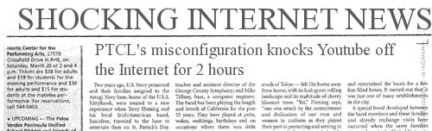

Challenges in Interdomain Routing (3)
Matters of trust
How to ensure routing misconfigurations are non-disruptive?
http://i25.tinypic.com/jsyr8l.jpg
Notes:
There are a few reasons why interdomain routing is hard. The first is simply a matter of scale. An Internet backbone router must be able to forward any packet destined anywhere in the Internet. That means having a routing table that will provide a match for any valid IP address. While CIDR has helped to control the number of distinct prefixes that are carried in the Internet’s backbone routing, there is inevitably a lot of routing information to pass around—on the order of 200,000 prefixes at the time of writing.
The second challenge in interdomain routing arises from the autonomous nature of the domains. Note that each domain may run its own interior routing protocols and use any scheme it chooses to assign metrics to paths. This means that it is impossible to calculate meaningful path costs for a path that crosses multiple ASs. A cost of 1000 across one provider might imply a great path, but it might mean an unacceptably bad one from another provider. As a result, interdomain routing advertises only “reachability.” The concept of reachability is basically a statement that “you can reach this network through this AS.” This means that for interdomain routing to pick an optimal path is essentially impossible.
The third challenge involves the issue of trust. Provider A might be unwilling to believe certain advertisements from provider B for fear that provider B will advertise erroneous routing information. For example, trusting provider B when he advertises a great route to anywhere in the Internet can be a disastrous choice if provider B turns out to have made a mistake configuring his routers or to have insufficient capacity to carry the traffic. Closely related to this issue is the need to support very flexible policies in interdomain routing.
One common policy is the prevention of transit traffic. For example, the multihomed corporation in Figure 4.29 may not wish to carry any traffic between the two providers to whom it connects. As a more complex example, provider A might wish to implement policies that say, “Use provider B only to reach these addresses,” “Use the path that crosses the fewest number of ASs,” or “Use AS x in preference to AS y.” The goal is to specify policies that lead to “good” paths, if not to optimal ones. When configuring BGP, the administrator of each AS picks at least one node to be a “BGP speaker,” which is essentially a spokesperson for the entire AS. That BGP speaker establishes BGP sessions to other BGP speakers in other ASs. These sessions are used to exchange reachability information among ASs. In addition to the BGP speakers, the AS has one or more border “gateways,” which need not be the same as the speakers. The border gateways are the routers through which packets enter and leave the AS. In our simple example in Figure 4.28, routers R2 and R4 would be border gateways. Note that we have avoided using the word “gateway” until this point because it tends to be confusing.We can’t avoid it here, given the name of the protocol we are describing. The important point to understand here is that, in the context of interdomain routing, a border gateway is simply an IP router that is charged with the task of forwarding packets between ASs.

Slide 9
Inter-AS protocols: EGP
EGP (name of protocol) is an example of an inter-AS routing protocol used in the early Internet
EGP was not scalable since it assumed simple relationships between AS (parent/ child relationship; tree structure; single-backbone – as shown below)
Notes:
Whereas the discussion of routing in the previous week’s lectures (IGP routing – DV and LS) focused on finding optimal paths based on minimizing some sort of link metric, the problem of inter-domain routing turns out to be so difficult that the goals are more modest.
First and foremost, the goal is to find any path to the intended destination that is loop-free. That is, we are more concerned with reachability than optimality. Finding a path that is anywhere close to optimal is considered a great achievement.We will see why this is so as we look at the details of BGP.
Now, we are in a position to discuss the two major inter-domain routing protocols in the recent history of the Internet.
1) The first was the Exterior Gateway Protocol (EGP). EGP had a number of limitations, perhaps the most severe of which was that it constrained the topology of the Internet rather significantly. EGP basically forced a treelike topology onto the Internet, or to be more precise, it was designed when the Internet had a treelike topology. EGP did not allow for the topology to become more general. Note that in this simple treelike structure, there is a single backbone, and autonomous systems are connected only as parents and children and not as peers.
2) The replacement for EGP is the Border Gateway Protocol (BGP), which is in its fourth version at the time of this writing (BGP-4). BGP is also known for being rather complex. This section presents the highlights of BGP-4. As a starting position, BGP assumes that the Internet is an arbitrarily interconnected set of ASs. This model is clearly general enough to accommodate non-tree structured internetworks, like the simplified picture of today’s multi-backbone Internet shown in the previous slide.
Unlike the simple tree-structured Internet shown in Figure 4.24, today’s Internet consists of an interconnection of multiple backbone networks (they are usually called service provider networks, and they are operated by private companies rather than the government), and sites are connected to each other in arbitrary ways. Some large corporations connect directly to one or more of the backbones, while others connect to smaller, non-backbone service providers. Many service providers exist mainly to provide service to “consumers” (i.e., individuals with PCs in their homes), and these providers must also connect to the backbone providers. Often many providers arrange to interconnect with each other at a single “peering point.” In short, it is hard to discern much structure at all in today’s Internet.

Slide 10

Border Gateway Protocol (BGP)
(the de-facto inter-AS routing protocol)
RFC 1771
TCP session over port 179
Replaced EGP
Decentralized approach
Moving away from earlier Internet model
BGP is a classless routing protocol and runs on TCP
to exchange reachability information between AS

Slide 11
Interdomain Routing Protocol
Interdomain Protocols have to deal with politics. As an example, few routing constraints are:
Do not carry commercial traffic on the educational network
Never send traffic from the pentagon on a route through Iraq
Traffic starting and ending at apple should not transit Google.
Etc.
Notes:
Scalability¹: Imagine that you're receiving 500,000 EBGP routes in more than one location², and you need to influence the per route exit point in your AS. BGP can handle many more routes than IGP protocols. Thus, iBGP is required unless you're willing to redistribute all the routes you've learned via eBGP
Enforce boundaries of trust / control: BGP has many more knobs than IGPs for controlling what you advertise and receive.
Flexible tools: BGP communities, BGP Extended communities, local-pref, etc... these make BGP an attractive way to implement custom routing policies within your own autonomous system (by using iBGP).
iBGP exchanges routing information internally between your own routers, where is customer A? Oh he's over on router F, ask the IGP how best to get there.

Slide 12
Two flavors of BGP: eBGP and iBGP
iBGP
eBGP
External BGP (eBGP): exchanging routes between Autonomous Systems
Internal BGP (iBGP): disseminating routes to external destinations among the routers within an AS
Question: What’s the difference between IGP and iBGP?
Slide credit: Nick Feamster (Georgia Tech)
Notes:
Scalability¹: Imagine that you're receiving 500,000 EBGP routes in more than one location², and you need to influence the per route exit point in your AS. BGP can handle many more routes than IGP protocols. Thus, iBGP is required unless you're willing to redistribute all the routes you've learned via eBGP
Enforce boundaries of trust / control: BGP has many more knobs than IGPs for controlling what you advertise and receive.
Flexible tools: BGP communities, BGP Extended communities, local-pref, etc... these make BGP an attractive way to implement custom routing policies within your own autonomous system (by using iBGP).
iBGP exchanges routing information internally between your own routers, where is customer A? Oh he's over on router F, ask the IGP how best to get there.

Slide 13
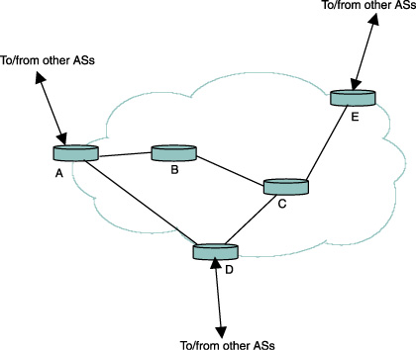
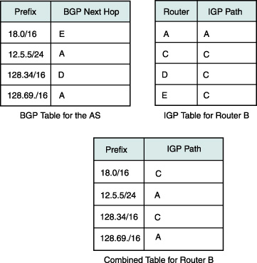
IGP and EGP Combination
Routers A, D, E run eBGP with external AS peers;
All routers run iBGP
IGP: Routes inside an AS to internal destinations
IBGP: Routes inside an AS to external destinations
Notes:
Routers use IGP to use IBGP next hop for external destinations.

Slide 14
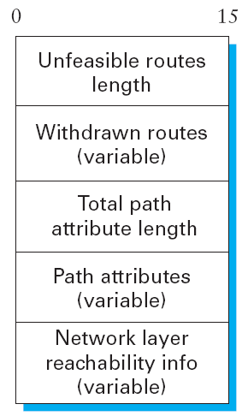
BGP Update Message and
BGP Path Attributes
The BGP attributes are a set of parameters that describe the characteristics of a prefix (route).
Origin
AS Path
Next Hop
Local-Pref
Multi-Exit Discriminator (MED)
Notes:
The following text is an excerpt from Sam Halabi’s authoritative book on BGP titled: Internet Routing Architectures“”
BGP attribute:
The BGP attributes are a set of parameters that describe the characteristics of a prefix (route). The BGP decision process couples these attributes with the prefix they describe, compares all the paths available to reach a given destination, and then selects the best routes to be used to reach the destination. Remember that attributes are part of each BGP UPDATE packet and describe the path information of the associated prefix.
Before I describe the BGP path attributes, let's take a brief look at the four separate categories of path attributes:
• Well-known mandatory
• Well-known discretionary
• Optional transitive
• Optional nontransitive
The following section was extracted from RFC 1771:
Well-known attributes must be recognized by all BGP implementations. Some of these attributes are mandatory and must be included in every UPDATE message. Others are discretionary and may or may not be sent in a particular UPDATE message. All well-known attributes must be passed along (after proper updating, if necessary) to other BGP peers.
The currently defined BGP attributes are described in the following list.
• ORIGIN (Type Code 1)—
A well-known mandatory attribute that defines the origin of the path information. The data octet can assume the following values:
o 0: IGP—
Network Layer Reachability Information that is interior to the originating AS
o 1: EGP—
Network Layer Reachability Information learned via EGP
o 2: INCOMPLETE—
Network Layer Reachability Information learned by some other means
BGP considers the ORIGIN attribute in its decision-making process to establish a preference ranking among multiple routes. Specifically, BGP prefers the path with the lowest origin type, where IGP is lower than EGP and EGP is lower than INCOMPLETE.
AS_PATH (Type Code 2)—
A well-known mandatory attribute that is composed of a sequence of AS path segments. Each AS path segment is represented by a triple <path segment type, path segment length, path segment value>.
The AS_PATH attribute is a well-known mandatory attribute (Type Code 2) that contains a sequence of autonomous system numbers that represent the path a route has traversed. Internally to an AS, routes passed among BGP speakers leave the AS_PATH information intact; however, when sending routes to external BGP peers, the AS that originates the route adds its own AS number. Thereafter, each AS that receives the route and passes it on to other EBGP peers will prepend its AS number to the list. Prepending is the act of adding the AS number to the beginning of the list. The final list represents all the AS numbers that a route has traversed. The AS number of the AS that originated the route is at the end of the list (just before the ORIGIN code). This type of AS_PATH list is referred to as an AS_SEQUENCE, because all the AS numbers are ordered sequentially.
NEXT_HOP (Type Code 3)—
A well-known mandatory attribute that defines the IP address of the border router that should be used as the next hop to the destinations listed in the Network Layer Reachability field of the UPDATE message.
MULTI_EXIT_DISC (Type Code 4)—
An optional nontransitive attribute that is a four-octet nonnegative integer. The value of this attribute may be used by a BGP speaker's decision process to discriminate among multiple exit points to a neighboring autonomous system.
• LOCAL_PREF (Type Code 5)—
A well-known discretionary attribute that is a four-octet nonnegative integer. It is used by a BGP speaker to inform other BGP speakers in its own autonomous system of the originating speaker's degree of preference for an advertised route.

Slide 15
BGP Path Attribute: Next-hop
Next-hop: 192.5.89.89
iBGP
Next-hop: 4.79.2.2
4.79.2.2
4.79.2.1
Next-hop: IP address to send packets en route to destination. (Question: How to ensure that the next-hop IP address is reachable?)
Slide credit: Nick Feamster (Georgia Tech)
Notes:
The Next_Hop attribute Identifies the next-hop IP address to be used as the BGP next hop to the destination
Reachability Information is usually Provided by the IGP, and changes in the IGP can influence the forwarding of the next-hop Address over a network backbone.

Slide 16
BGP Path Attribute: Local Preference
Traffic
Higher local pref
Primary
Destination
Backup
Lower local pref
Control over outbound traffic
Used to prefer exit point from local AS
Useful for preferring routes from one AS over another (e.g., primary-backup semantics)
A router with higher value for local-pref is used to exit the AS
Slide credit: Nick Feamster (Georgia Tech)

Slide 17
BGP Path Attribute: AS Path
AS1-AS2-AS3 is shorter than
AS4-AS5-AS6-AS7
Traffic
Destination
Among routes with highest local preference, select route with shortest AS path length
Shortest AS path != shortest path, for any interpretation of “shortest path”
Avoids loops, rejects adverts with its own ID in AS-Path
Slide credit: Nick Feamster (Georgia Tech)

Slide 18
BGP Path Attribute: MED
(multi-exit discriminator)
San Francisco
Dest.
New York
MED: 20
Traffic
MED: 10
I
Los Angeles
Control over inbound traffic
Mechanism for AS to control how traffic enters it, given multiple possible entry points
Router with lower value is selected as entry point
Slide credit: Nick Feamster (Georgia Tech)
Notes:
MED is an optional nontransitive attribute. MED is a hint to external neighbors about the preferred path into an autonomous system (AS) that has multiple entry points. The MED is also known as the external metric of a route. A lower MED value is preferred over a higher value.http://www.cisco.com/c/en/us/support/docs/ip/border-gateway-protocol-bgp/112965-bgpmed-attr-00.html
MED:
Based on web search results, a multi-exit discriminator (MED) is a BGP attribute that can be used to influence the routing decision of a neighboring autonomous system (AS) when there are multiple paths to reach the same destination. A lower MED value is preferred over a higher value, and a missing MED value is treated as zero by default. The MED attribute is optional and non-transitive, meaning that it is not always sent with BGP updates and it is not propagated beyond the adjacent ASes¹²³⁴.
Source: Conversation with Bing, 5/5/2023(1) Use Multi-Exit Discriminator to Select Best Path for BGP Router. https://www.cisco.com/c/en/us/support/docs/ip/border-gateway-protocol-bgp/13759-37.html Accessed 5/5/2023.
(2) The BGP MED (Multi Exit Discriminator) attribute | Noction. https://www.noction.com/blog/bgp-med-attribute Accessed 5/5/2023.
(3) BGP MED Attribute | Junos OS | Juniper Networks. https://www.juniper.net/documentation/us/en/software/junos/bgp/topics/topic-map/med-attribute.html Accessed 5/5/2023.
(4) A Look into the BGP MED Attribute. https://www.packetcoders.io/a-look-into-bgps-med-attribute/ Accessed 5/5/2023.

Slide 19
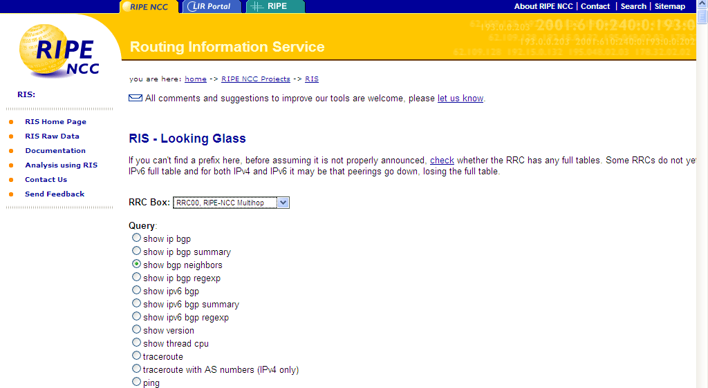
To learn more:
http://www.ripe.net/projects/ris/index.html
Also, see http://traceroute.org

Slide 20


References
Chapter 4:
The Network Layer [K&R]
Section 4.5 and 4.6 (in particular)
Chapter 4:
Internetworking [P&D]
Section 4.2

Slide 21
[ End of lecture ]

